Slide 1


Tulsiramji Gaikwad-Patil College of Engineering & Technology, Nagpur-441108
Department of Master in Computer Application
M.C.A Fizrst Year(II Semester)
Employee Management System
Presented by
Dipti Sanjay Sawarkar
Guided by:
Prof. T.P.Raju
Assistant Professor
Master of Computer Application
TGPCET, Nagpur.

Slide 2
Objective
Employee Management System is a web based technology in which an admin can add employees, assign projects and grant the leaves of the employee, adding with it we can see the project status and salary table. And on other hand the employee can view his profile apply for leave and view his project.
EMS we are using HTML5 and CSS3 front end and JavaScript, PHP for backend and MYSQL for database and WAMP/XAMP server for testing.

Slide 3
Modules
ADMIN
Home
Add Employee
View Employee
Assign Project
Project Status
Salary TableEmployee leave:
EMPLOYEE
Home
My info
My Project
Apply Leave

Slide 4
ADMIN
Home: Employee leader board is displayed.
Add Employee: Admin can add employee here.
View Employee: Admin can view, edit and Delete employee in this page.
Assign Project: Admin can assign project for employee.
Project Status: Admin can assign project to employee in this page.
Salary Table: Admin can view the salary of the employees.
Employee leave: Admin can approve or cancel the leave.
EMPLOYEE
Home: Employee can see his due projects, his leave project, and salary status over here.
My info: An employee can view his own profile in this tab.
My Project: Employee can see the projects assigned to him.
Apply Leave: Employee can apply for leave and check his leave status.

Slide 5
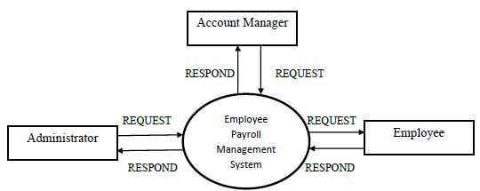
Zero level DFD

Slide 6
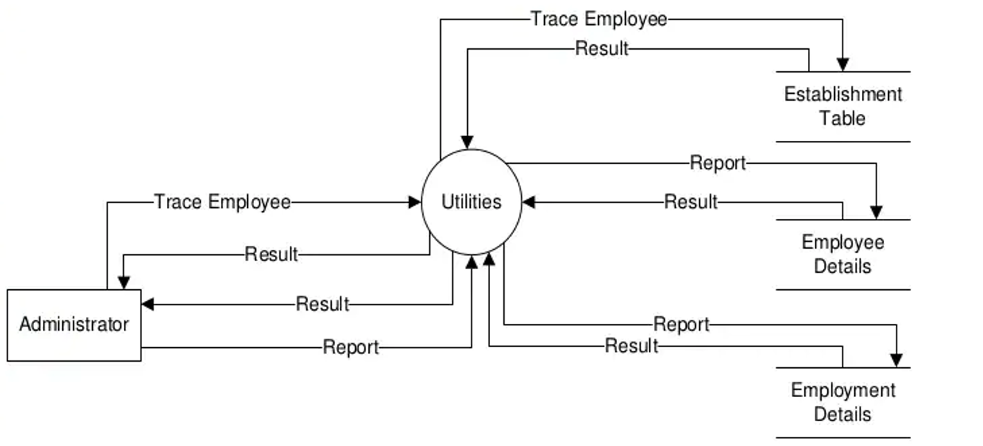
First level DFD

Slide 7
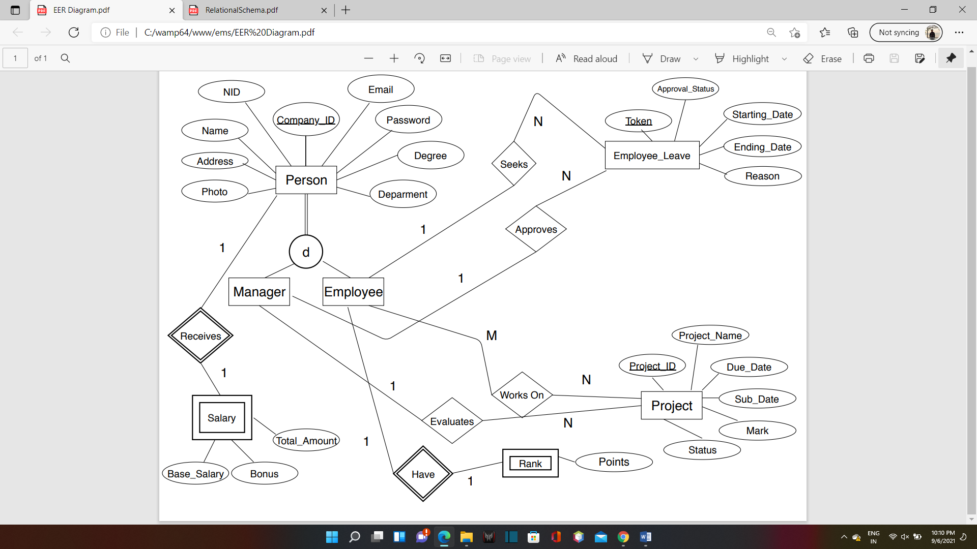
ERD

Slide 8
Frontend
HTML5
CSS
JavaScript

Slide 9
Backend
Php
MySQL
Wamp server

Slide 10
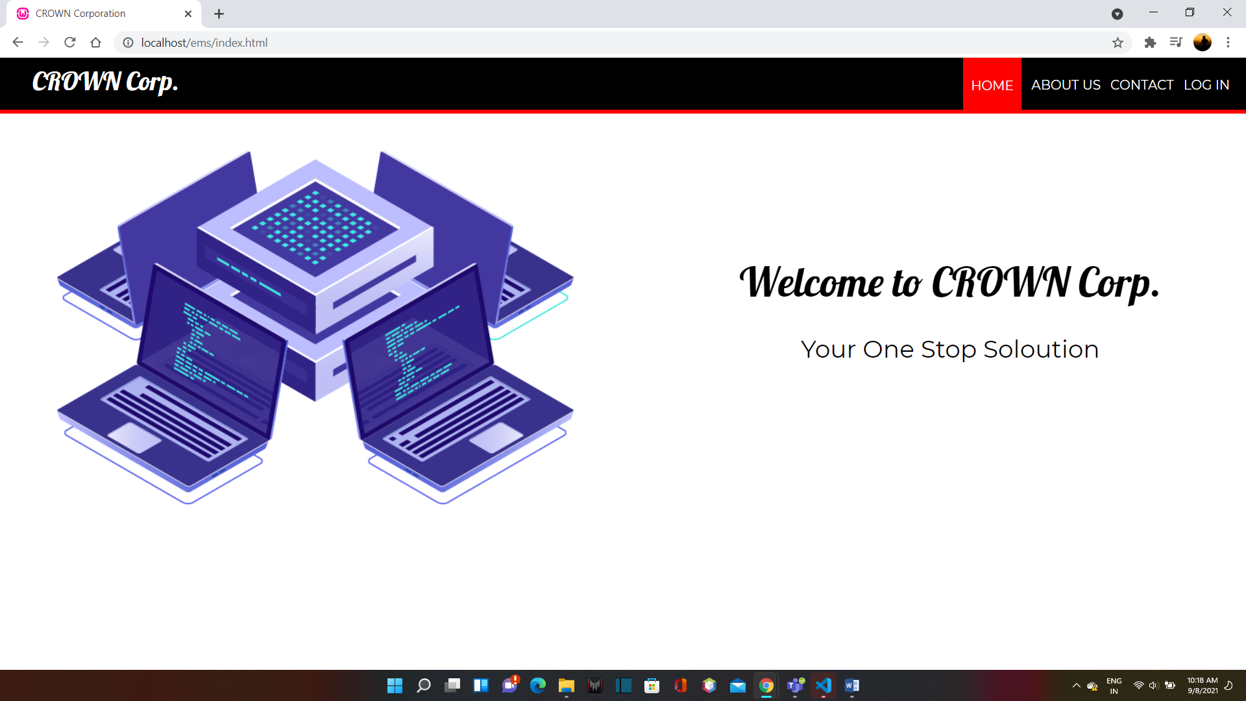
home page

Slide 11
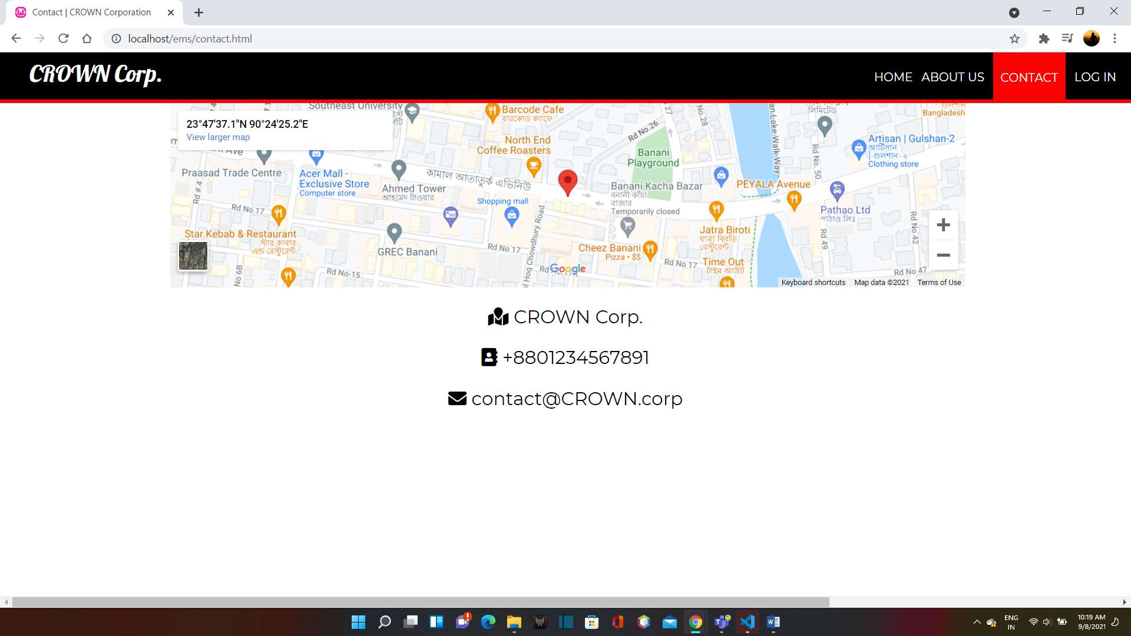
Contact

Slide 12
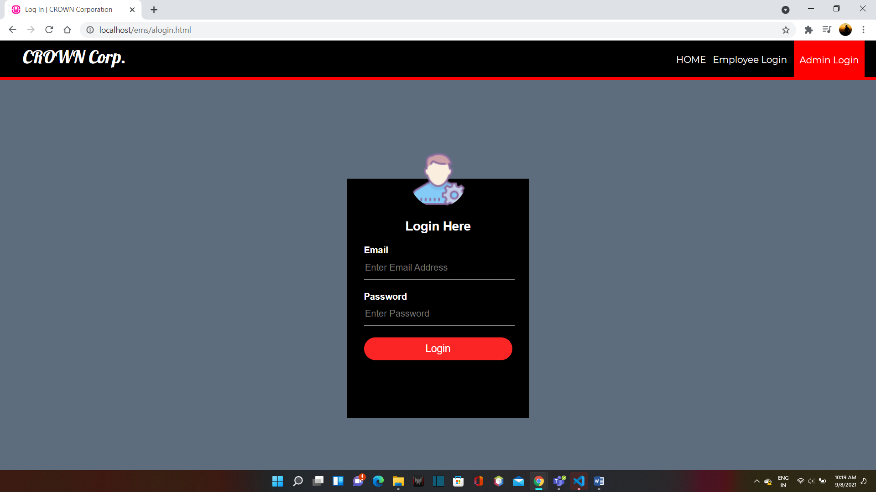
Admin login

Slide 13
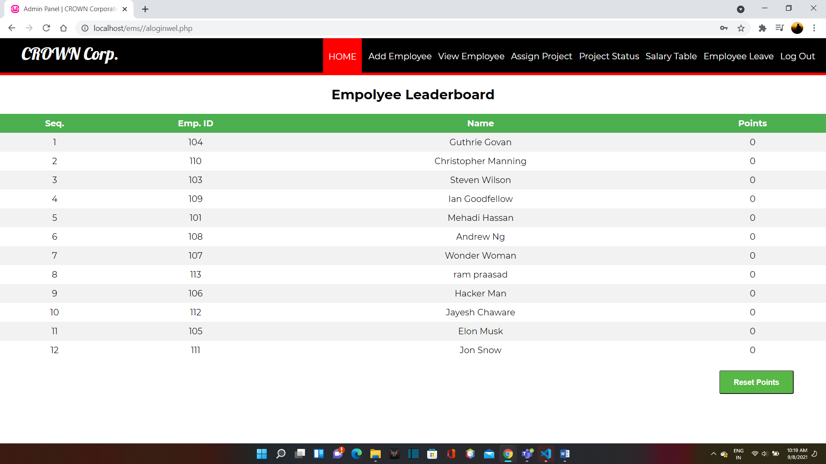
Admin home

Slide 14
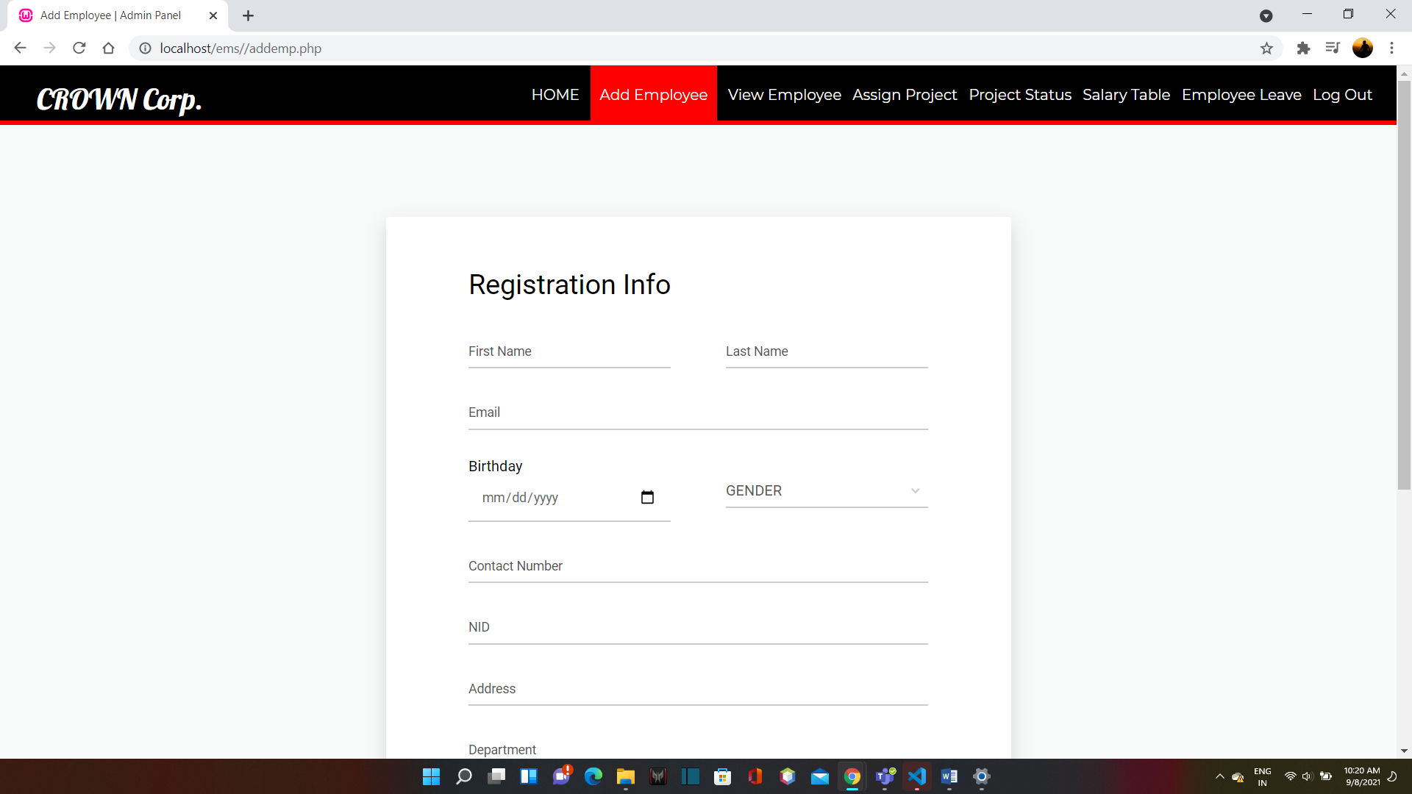
Add employee

Slide 15
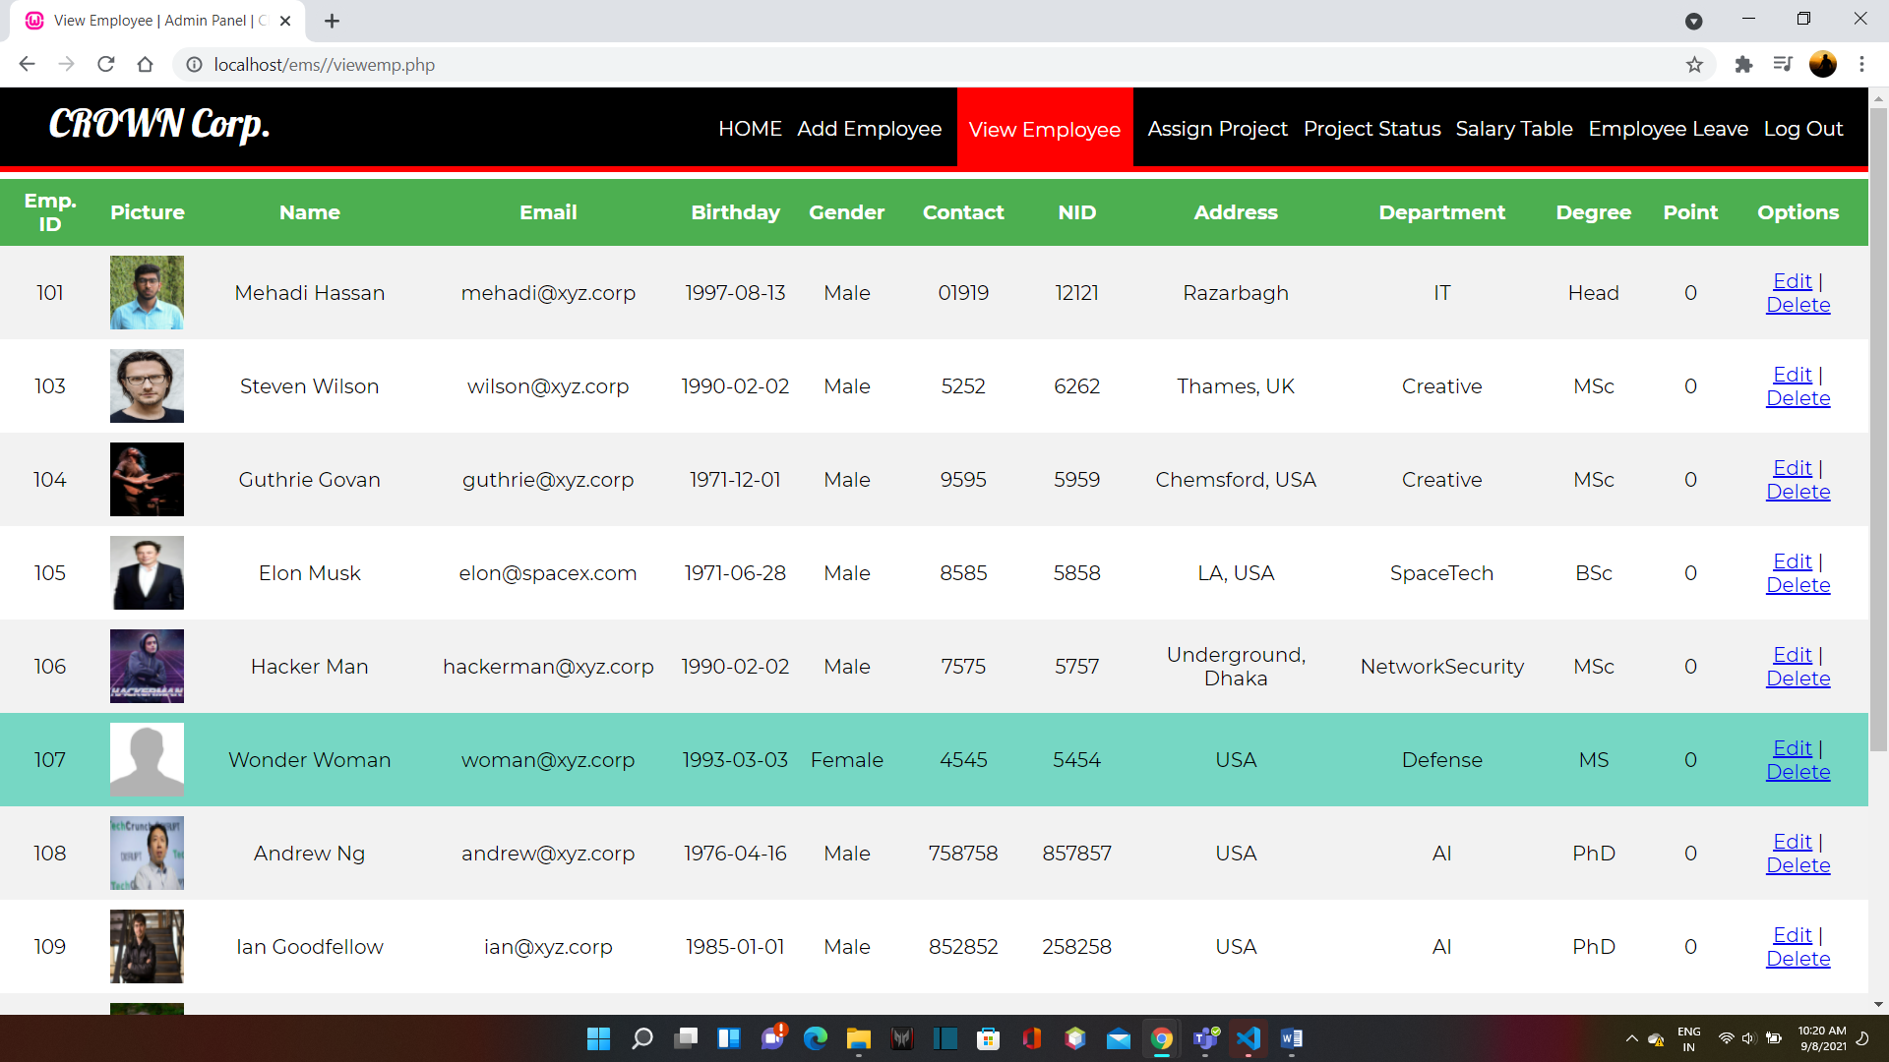
View employee

Slide 16
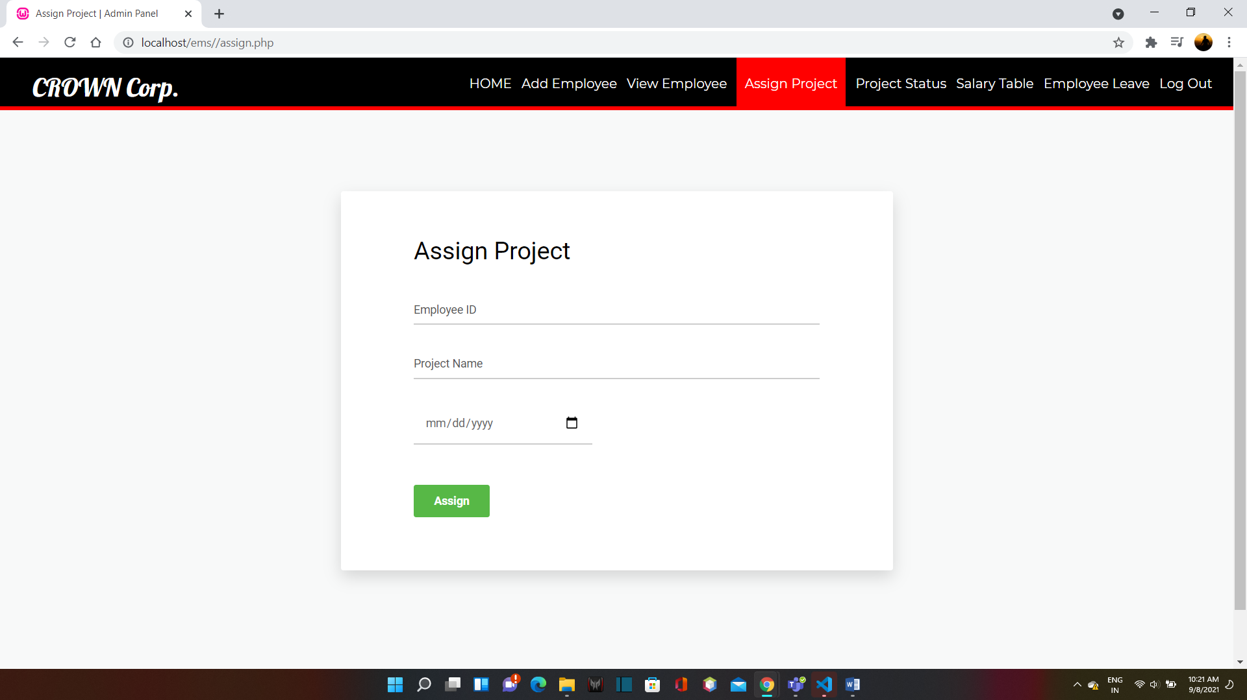
Assign Project

Slide 17
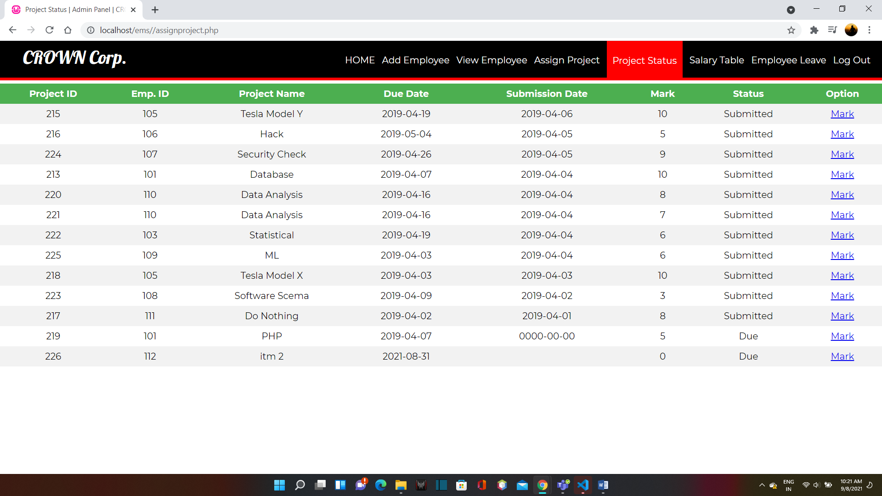
Project Status

Slide 18
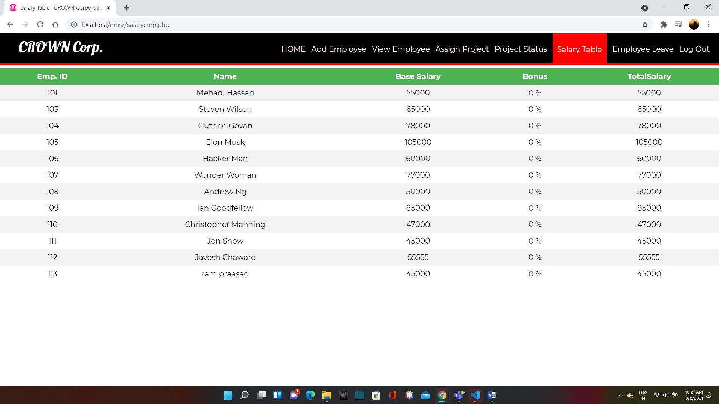
Salary Table

Slide 19
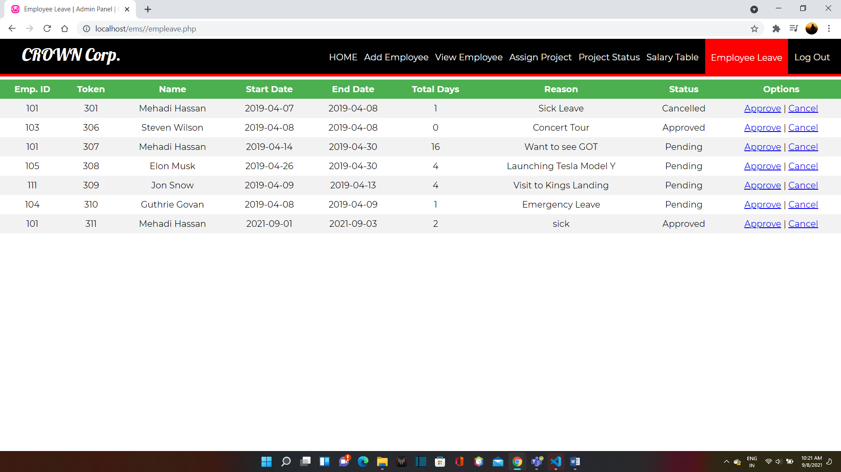
Employee Leave

Slide 20
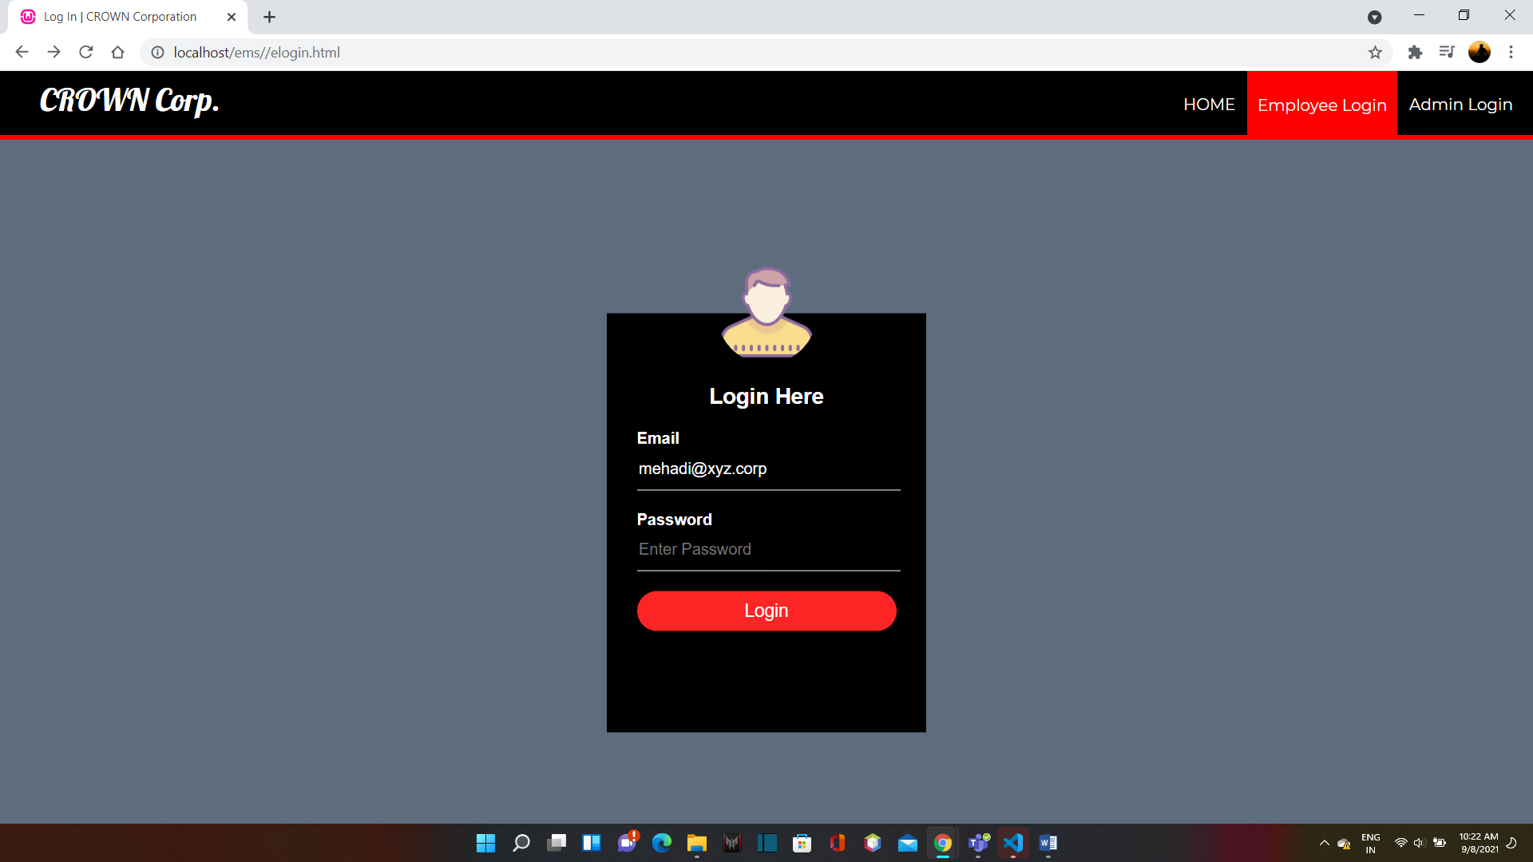
Employee Login

Slide 21
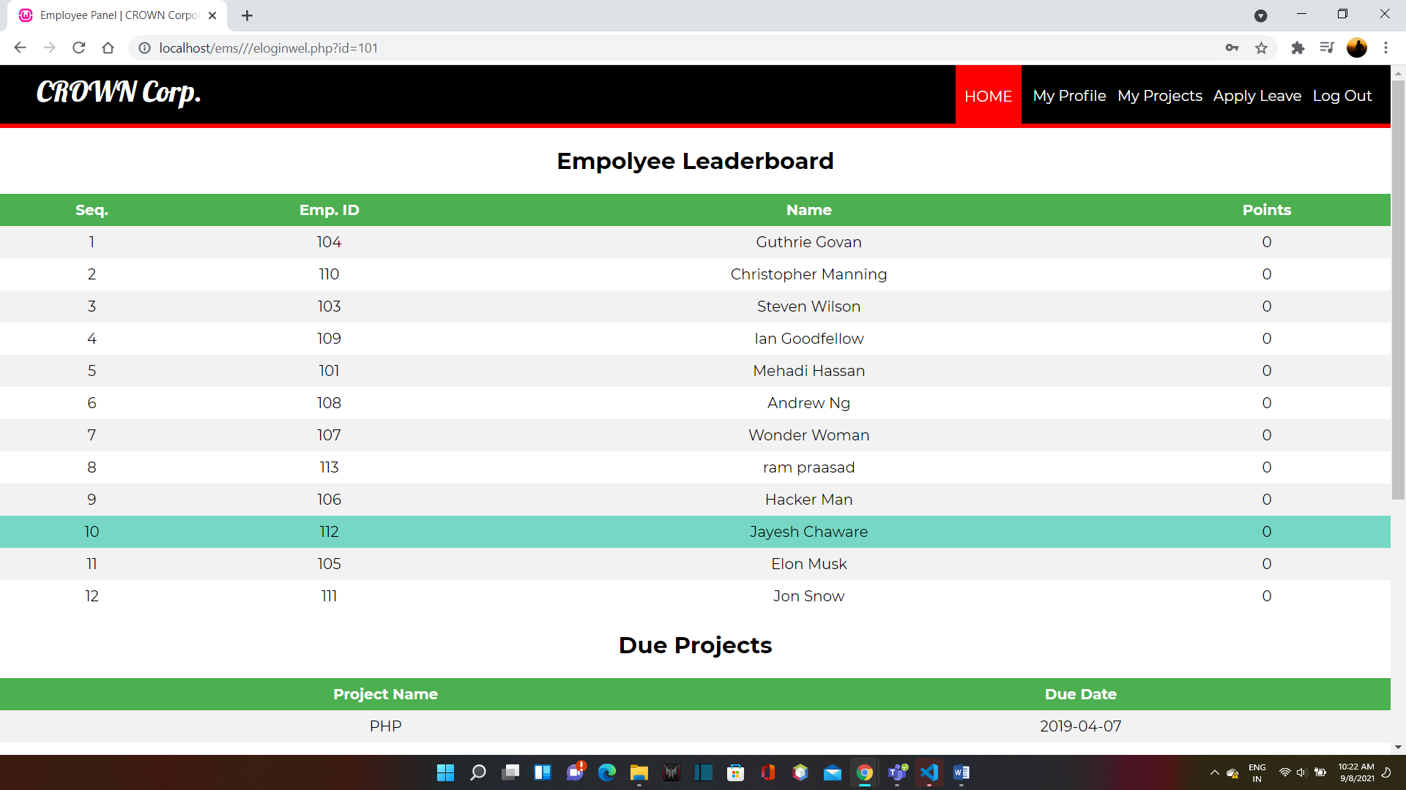
Employee Home

Slide 22
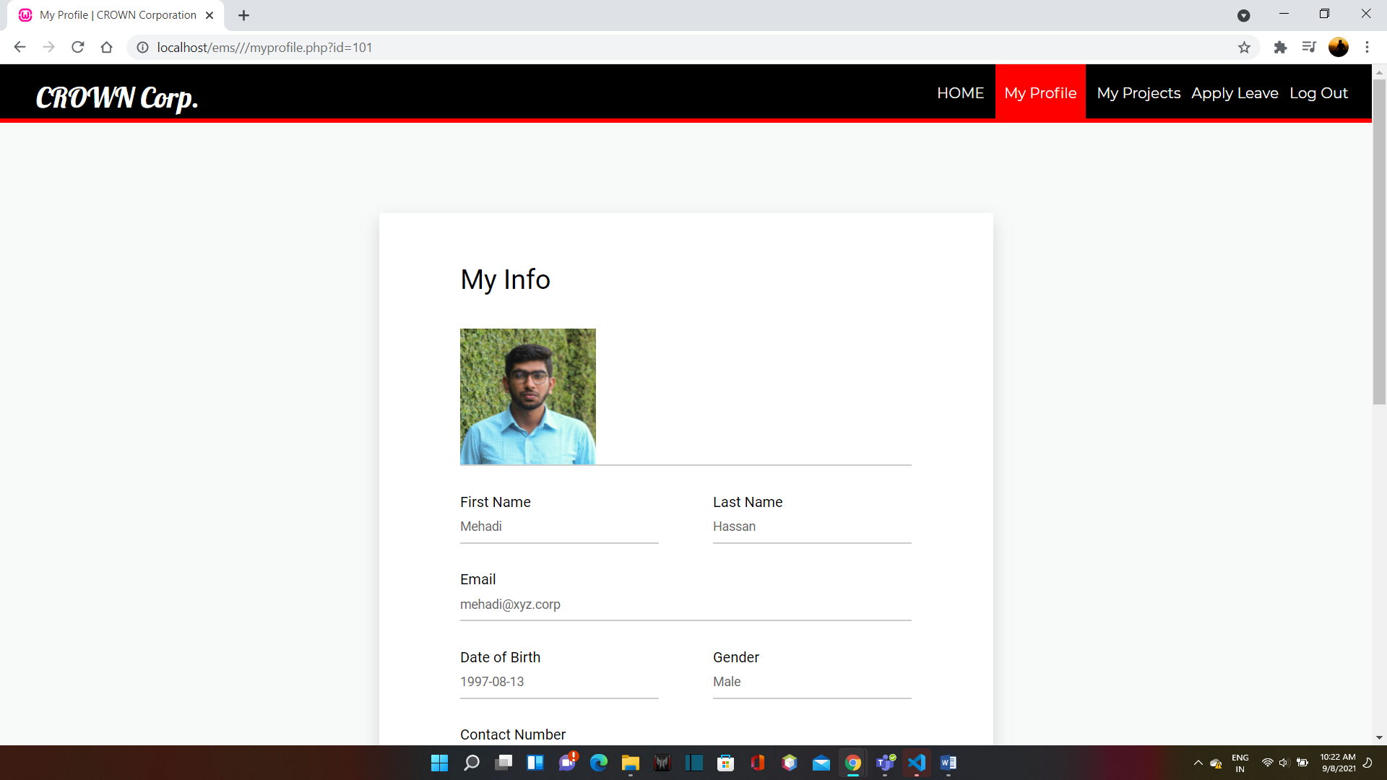
My Profile

Slide 23
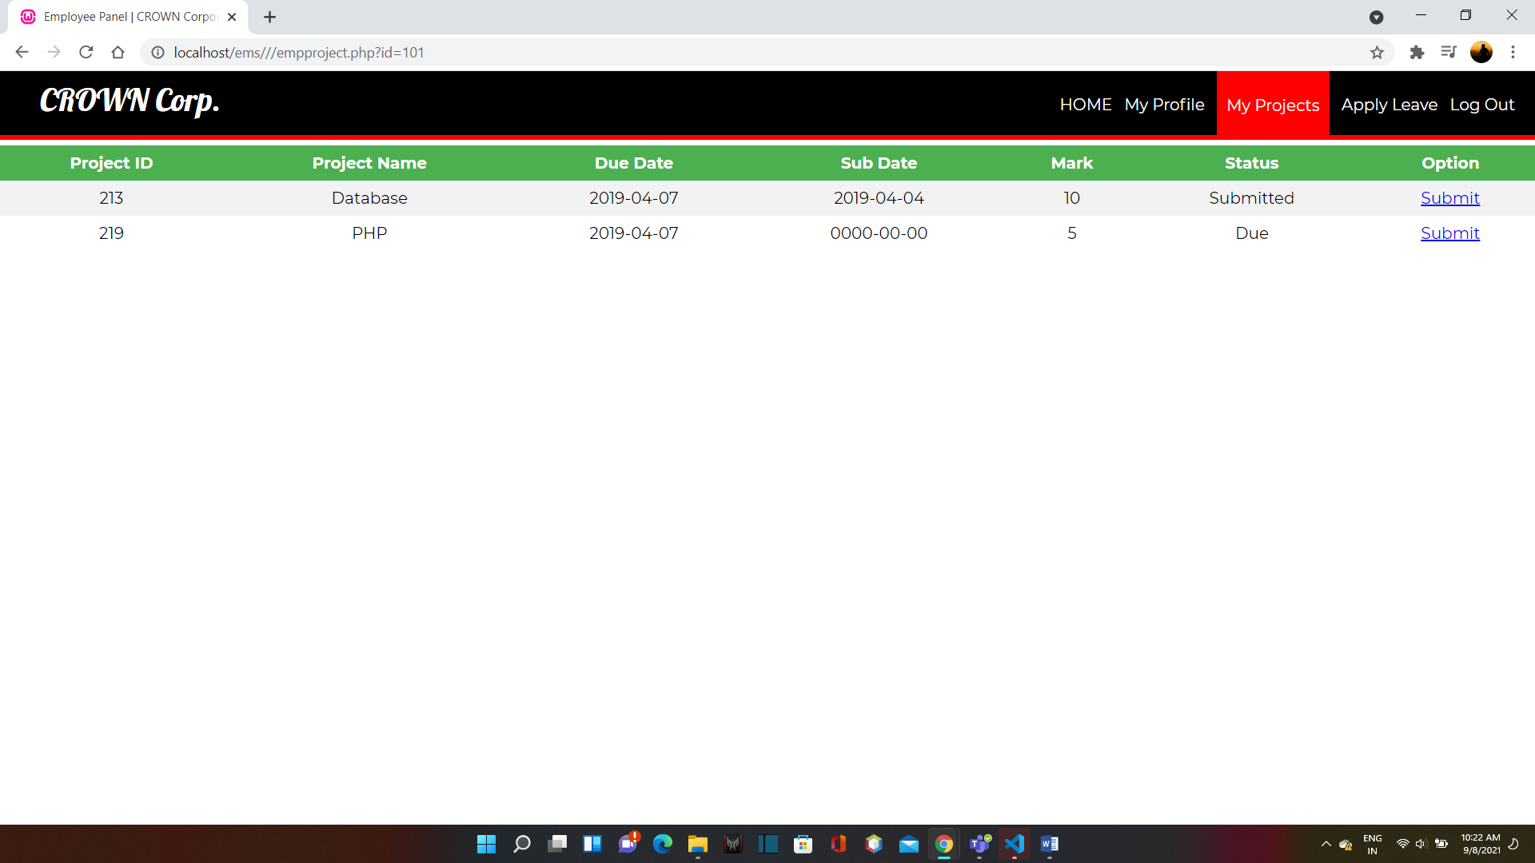
My Project

Slide 24
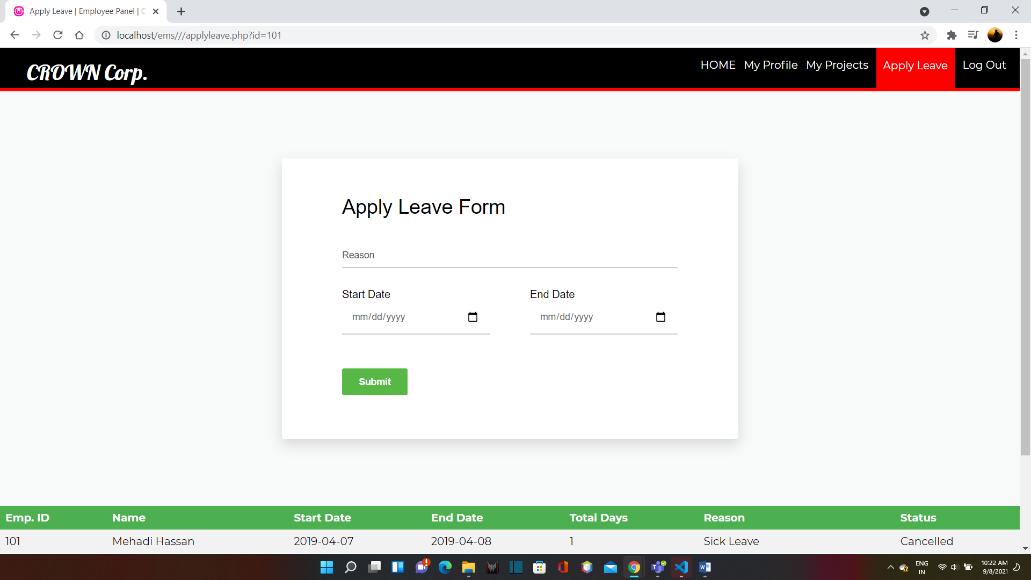
Apply leave

Slide 25
Thank You!

